Slide 1
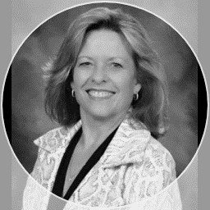
Dianne K. King
Career Development Coordinator
dking80@forsyth.k12.ga.us
Denmark High School
West Forsyth High School

Slide 2
Agenda
Who am I?
What is an internship?
Why consider an internship?
Who may participate in an internship?
What are the course/internship expectations?
Where do students intern?
How do students apply?
How do parents/students register for Remind to get the latest information?

Slide 3
Who am I?
CDC for 2 awesome schools – DHS and WFHS
I love helping students find their passion!
Website: https://dkingcdc.weebly.com/
Dr. Marelle Bowers Email: f38182@forsyth.k12.ga.us Alliance Academy for Innovation | Dr. Nancy Ruff Email: nruff@forsyth.k12.ga.us South Forsyth HS
​Hailey Brock Email: ​f39417@forsyth.k12.ga.us East Forsyth HS and North Forsyth HS | Lauren Westbrook ​Email: lwestbrook@forsyth.k12.ga.us Forsyth Central HS
Susan Fagan Email: sfagan@forsyth.k12.ga.us Lambert HS

Slide 4
What is an internship?
An internship is a work experience opportunity offered by an organization. It may be:
paid or unpaid
in person or virtual
off campus or on campus in a school enterprise (school store/print shop/etc.)
The State of Georgia calls all internships Work-Based Learning (WBL).
Forsyth County Schools has two WBL programs:
Internship Forsyth – most students apply for this program – Examples:
Marketing student working at Chick-fil-A for pay.
Marketing student working in a Marketing firm for experience.
Mentorship Forsyth – includes a year-long capstone research project

Slide 5
Why consider an internship?
Course credit that fits your schedule – up to 3 periods a day
One period = 5 hours of work/internship a week
Two periods = 10 hours of work/internship a week
Three periods = 15 hours of work/internship a week
Job shadow (unpaid) or work (paid) opportunities qualify
Current position may qualify
Gain marketable skills, while in high school, that match current and future career demands
Assist with college/career planning
Networking opportunity that can lead to other opportunities
Connects classroom learning to an on-the-job experience
It may be a great fit if you are going to be an off-campus students next year taking virtual or dual enrollment courses.
Looks great on job applications and resumes!

Slide 6
Did you Know?
50% of students begin college undecided about their major.
33% of college students change their major at least once.
Students are often unaware that certain careers don’t require a 4-year degree.
Internships can often help students save time and money!

Slide 7
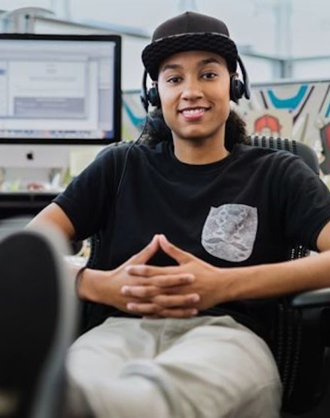
Who Benefits from an Internship Forsyth experience?
Most students!
Students who have or will complete a career pathway
Students who are interested in pursuing a career in their pathway and want to learn more
Students who have a qualifying position they enjoy and want to continue

Slide 8
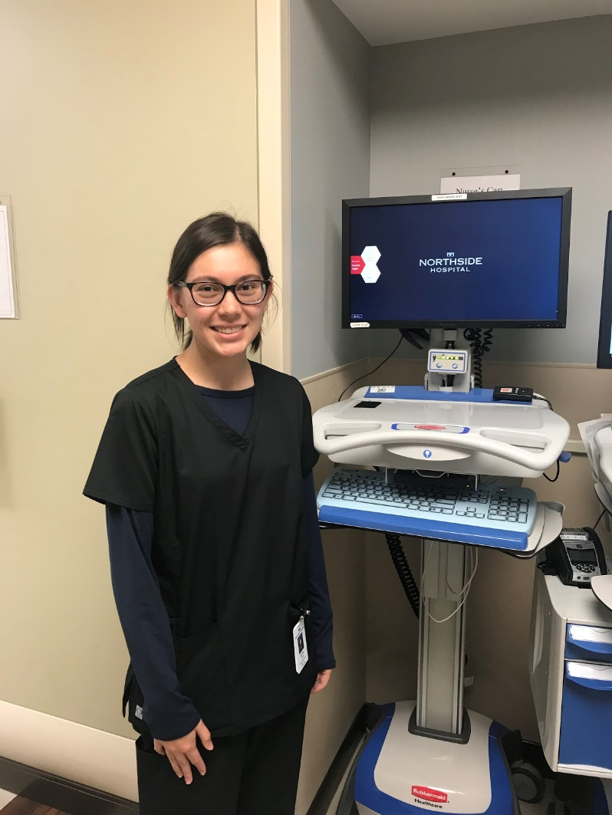
Who may participate?
Juniors and Seniors
(Must be 16 by September 1)
Students must have completed at least one course in a pathway; two courses are preferred.
Preference is given to students pursuing a career (CTAE) pathway; but other qualifying pathways include fine arts, world language, and AP.
Students must have reliable transportation.
Students are selected based on academic record, attendance, and teacher recommendations.
Students must demonstrate a positive attitude, a strong work ethic, and be able to work well with adults.

Slide 9
What are the expectations?
Work/job shadow at least 5 hours per week for every internship period…up to 3 periods.
Note: Internship hours can be anytime during the week.
Submit monthly documentation of internship hours.
Be evaluated by your supervisor/mentor quarterly.
Complete monthly assignments related to general employment skills and knowledge.
Attend monthly meetings.
Participate in mock interviews.
Mentorship Forsyth – includes year-long capstone research project.

Slide 10
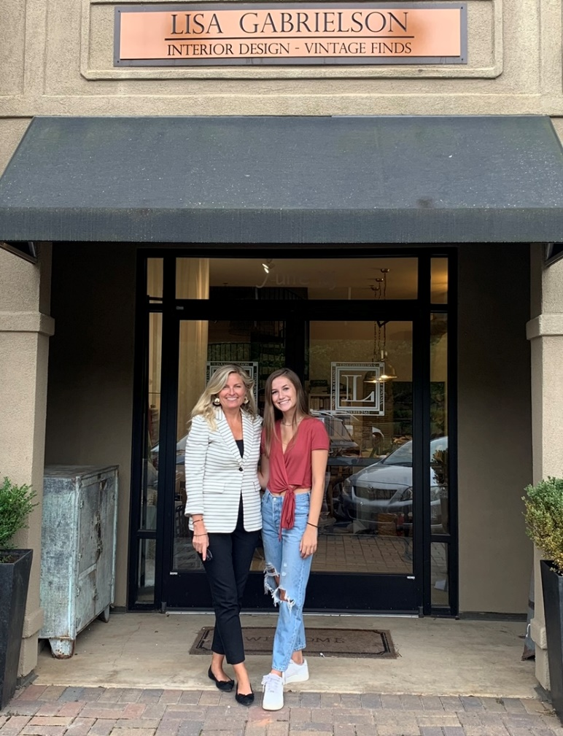
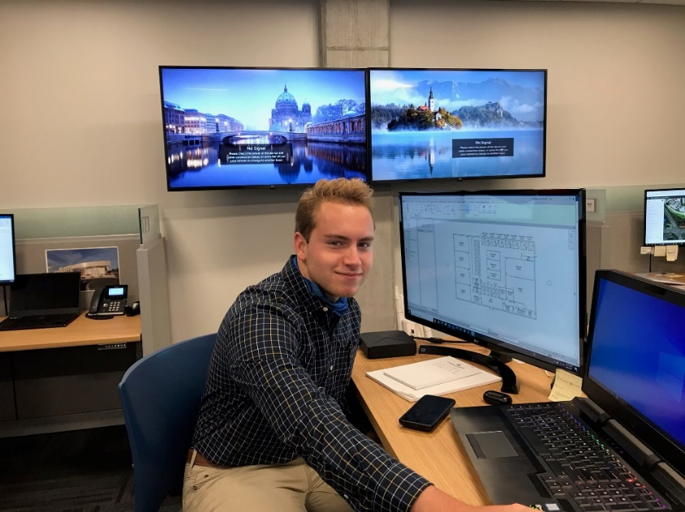
Where do Students Intern? Everywhere…
Accounting firms
Animal clinics/hospitals
Athletic and golf clubs/courses
Biotech companies
Construction companies
Engineering firms
Farms and other AG businesses
Forsyth County Public Library
Interior design studios
Lanier Flight Center
Law firms
Northside Hospital
On campus – school-run businesses
Photography studios
Real estate offices
Restaurants
Salons and spas
Sheriff’s Department
Siemens
The Place of Forsyth
The Collection and Halcyon businesses

Slide 11
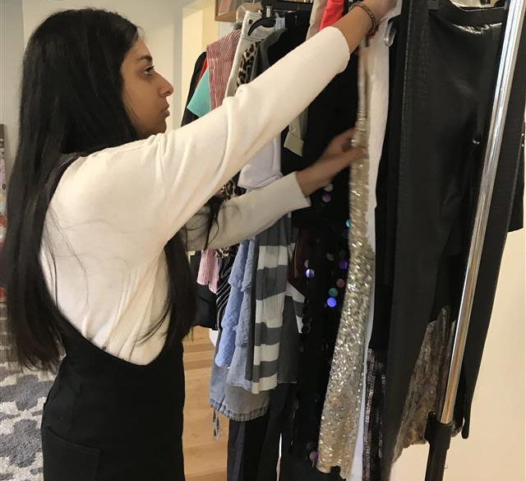
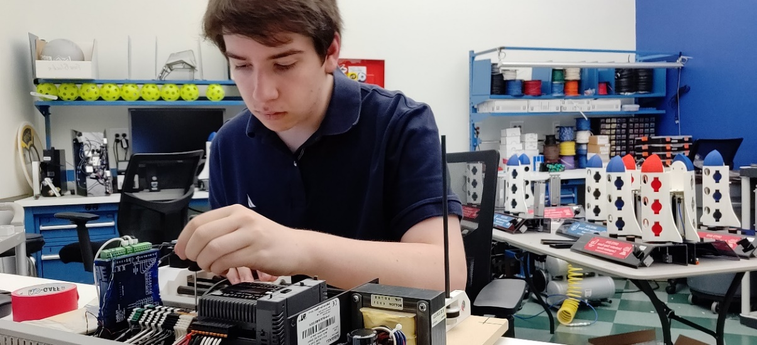
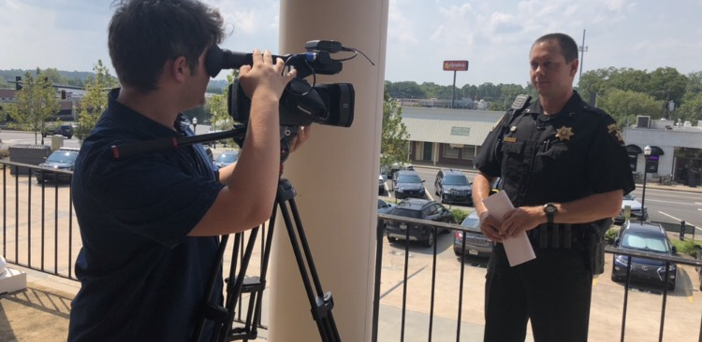
How do I apply?
Submit an online application by Wednesday, February 23, 2022!
Apply early!
County website link and QR code are at the end of this presentation.
Online application should be ready beginning Monday, January 10.

Slide 12
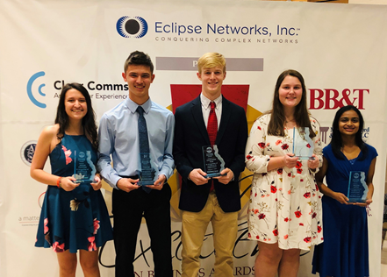
Does completing an application commit me to participating next year?
Not at all!
It’s simply the first requirement to even being considered!

Slide 14
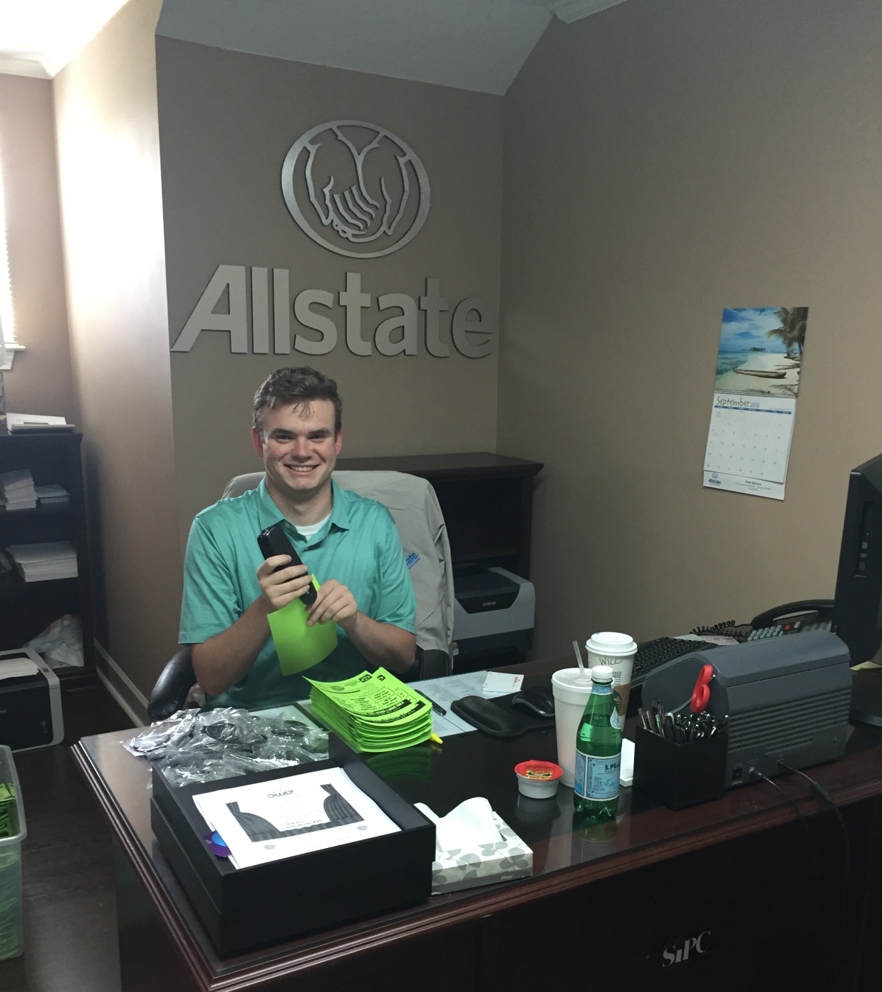
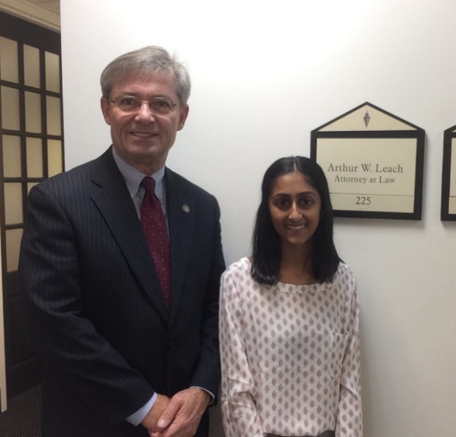
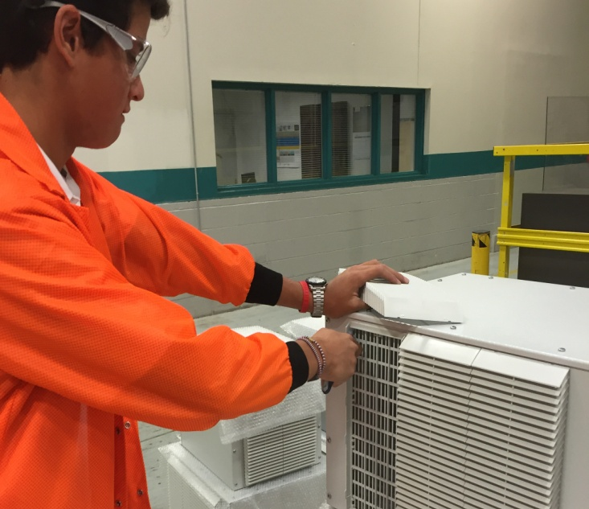
For the latest application information, info sessions, and reminders, please register for your school’s Internship Forsyth Interest Group Remind:
Denmark High School:
Text @intern4dhs to the number 81010
West Forsyth High School:
Text @intern4wfh to the number 81010

Slide 15
Dianne K. King
Career Development Coordinator
Schools: Denmark and West Forsyth High Schools
Email: dking80@forsyth.k12.ga.us
Website: https://dkingcdc.weebly.com/internships--mentorships.html

Slide 16
Thank you!

