Slide 1
Course Orientation
August 3, 2021
Notes:
Hello and Welcome to the 2020-2021 Internship Forsyth Kickoff Presentation!

Slide 2
Today we will discuss these questions…
What is Internship Forsyth?
Why do we use itsLearning?
What if I am still looking for a job/placement?
What if I am a 2nd year student?
What documents are required by me and my mentor/supervisor, and when will they be ready?
What are the requirements for monthly meetings, and will they be virtual?
How am I graded?
What are my next steps?
Notes:
Our goal for this presentation is to answer some questions you may have about Internship Forsyth.

Slide 3
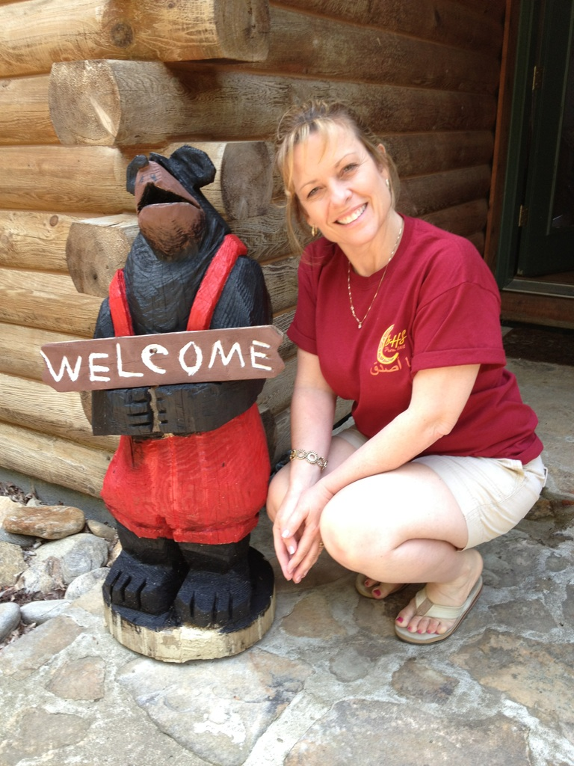
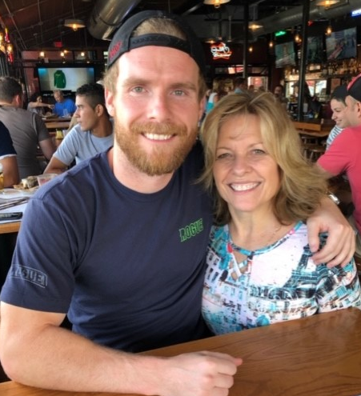
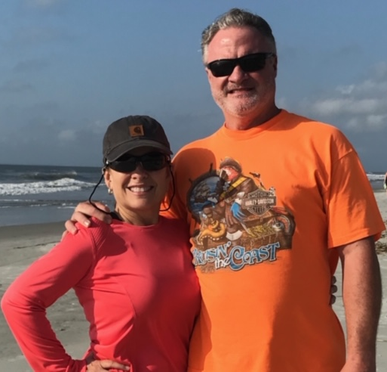
Who am I?
Dianne King
Career Development Coordinator – DHS and WFHS
Passion for helping students find their passion ☺
Locations:
Tuesdays – WFHS – Office 1249
Thursdays – DHS – Office 2006
Best Contact:
Email: dking80@forsyth.k12.ga.us
Remind
Cannot wait to learn more about you!
Notes:
My name is Dianne King.
I am honored to be the Career Development Coordinator for DHS and WFHS again this year.
I’ve taught at SFHS and have also served LHS and NFHS students in the past.
I am a Certified Global Career Development Facilitator and truly have a passion for helping students find their passion.
I have a husband and two grown children and love being outside…especially during times like these.
I spend my time all over the school system but am scheduled to be on the WFHS campus on Tuesdays and the DHS campus on Fridays.
Since I travel around so much, the best way to reach me is through email and Remind. As the year begins, I cannot wait to learn more about each of you.

Slide 4
Remind
Denmark High School
Text the message @internsdhs to the number 81010.
West Forsyth High School
Text the message @internswfh to the number 81010.
Since I am at multiple schools, this will be the fastest and best way for me to communicate with you regarding any changes/updates.
Not registered… please do now!
Notes:
If you have not registered for Remind notifications, please do so immediately. I send important texts frequently and also can receive return texts from you through Remind.
I’ve listed the remind info for both schools here.
And…since our situation is every changing during the pandemic, it’s an easy and quick way to communicate with you.

Slide 5
What is Internship Forsyth?
Fabulous Opportunity
State of Georgia Course – Georgia values internships!
Credit is earned through interning/working and completing coursework.
One course credit for every 5 hours worked – Up to 3 periods/credits
On your schedule
Types of Interns – Not one “size”
Paid vs Unpaid
On Campus vs Off Campus
Virtual vs In Person
In Pathway vs Out of Pathway Placements
First Year vs Second Year
We all utilize itsLearning!

Slide 6
itsLearning
Will be ready soon!
itsLearning – How we will use:
Copies of all documents for course
Assignment/Document submission
It will be your ultimate resource once ready.
2nd Year Students – You will be exempt from many assignments this year.
Finding a Job:
August 19 – Deadline to find and begin working in a job/placement.
Find what you love. Be creative.
Virtual internships are acceptable.
Hours may be worked anytime during the week.

Slide 7
Documents – Required by State of GA
You will receive these electronic eDocuments from me by email when ready at the end of August.
PandaDocs:
Our electronic document platform. We use for our Intake Forms and our Hours Documentation.
Everyone receives through email for signature. Once all parties sign, everyone receives a finalized copy.
Interns are responsible for submitting completed copies as an itsLearning assignment.
Intake Packet Distribution and Due Date:
Makes your placement official.
Will be emailed toward the end of August. Target date is Monday, August 23.
It is due September 10.
Intake Packet Content:
Student Data Sheet
Parent/Guardian Enrollment Consent
Harassment/Confidentiality/Security Document
Syllabus
Employer Documents
Training/Expectations Agreement
Training Plan

Slide 8
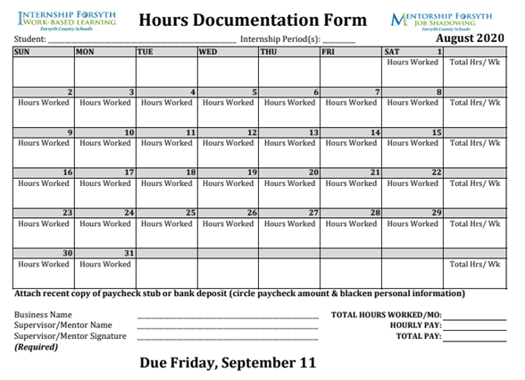
Documents – Required by State of GA
You will receive these electronic eDocuments from me by email when ready at the end of August.
Documentation of Hours/Pay – Monthly
Will be emailed toward the end of August.
Target date is Monday, August 23.
August hours will be due September 10.
Keep track of your hours until your form is ready.
Hours – Varies by month – On Form and itsLearning
Calendar
Must be signed by supervisor/mentor
Submit PDF of completed form through itsLearning
SAMPLE

Slide 9
Monthly Meetings
Mandatory Monthly Meetings
Purpose: To keep us on track for upcoming events/assignments.
When:
Schedule and Details will be uploaded in itsLearning when ready.
Our first meeting will be August 20 – Off campus – discuss in a minute
Our regular meetings will be once a month - Tuesdays for WFHS and Thursdays for DHS.
They will not be long – 15-20 minutes
Where: TBD
There will always be a virtual option!
Can always schedule additional appointments if needed ☺

Slide 10
Quarterly Site Visits
Site Visits
I will be conducting quarterly site visits as possible following all business protocols.
If you are a virtual intern, I will request a virtual meeting with your supervisor/mentor.
Visits are required by the state to ensure all is going well in your internship.

Slide 11
Grades
itsLearning Assignments – including submitting your hours each month
Employer/Mentor Evaluations
Meetings – Monthly – Virtual/F2F Option – Beginning September
Events
August 20 – Internship/Mentorship Kick-Off Event
JA Discovery Center
Mock Interview Prep and Interviews
Important Reminders:
The emphasis is to do extremely well in your internship! Be professional! Learn all you can! Represent yourself, your school, and this program well!
However, your internship is not more important than school! Make sure you are doing a great job in each of your classes.

Slide 12
Intern Responsibility
Below are serious infractions that may lead to your failing this course or removal from the program.
Leaving position without coordinator’s prior permission.
Leaving position without submitting a proper two-week notice.
Being fired from your position.
Changing jobs more than one time during the school year.
Falsifying hours documentation or other reports.

Slide 13
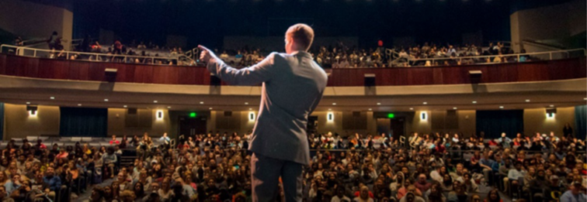
Fall Event – August 20 - Internship/Mentorship Kickoff! All FCS Internship/Mentorship Students Browns Bridge Church Morning & Afternoon Sessions – You choose! Transportation not provided Summative Grade Permission Slip Step 1: Download, complete, sign Step 2: Turn in to my office on or before August 13 (DHS – Office #2006; WFHS – Office #1249)

Slide 14
Spring Events – Tentative JA Discovery Center Mock Interview Prep Event Mock Interviews

Slide 15
Volunteer at JA Discovery Center Location: Alliance Academy
Approved Field Trip
Should be completed by May 1.
You are going to LOVE this experience! #resumebuilder

Slide 16
Mock Interview Prep Event and Mock Interviews
Mock Interview Prep Event
Professional Trainers
Focus on interview Skills
Mock Interviews
Volunteers from Community
Excellent Experience
Networking Opportunity
WFHS – March 14-18, 2022
DHS – March 1-4, 2022

Slide 17
Next Steps:
To Do:
Complete Field Trip Form for August 20 Event.
Print
Complete
Turn into Mrs. King’s office by Friday, August 13.
Wait for Mrs. King to send Remind text that items are ready:
itsLearning
E-Docs
Contact your counselor if your internship period(s) are not at the time needed/requested.
If you don’t have a placement,
Reach out to places you’d like to work/intern. You have until August 19 to get started.
Consider any virtual options with local businesses.
Stop by to see Mrs. King Thursday or Friday.

Slide 18
Next Steps:
First Days of School
Thursday – I’ll be at WFHS ; Friday – I’ll be at DHS
You do not need to come see me. But… Please come see me:
If you don’t have a placement
If you have questions
If you need a hard copy of the permission slip
Remember: You must leave campus for your internship period(s). You are not allowed to remain on campus during your internship period if you are not interning for a teacher on campus.
Mrs. King’s location this week only:
West Forsyth High School – Thursday, August 5 – #2146
Denmark High School – Friday, August 6 – Media Center

Slide 19
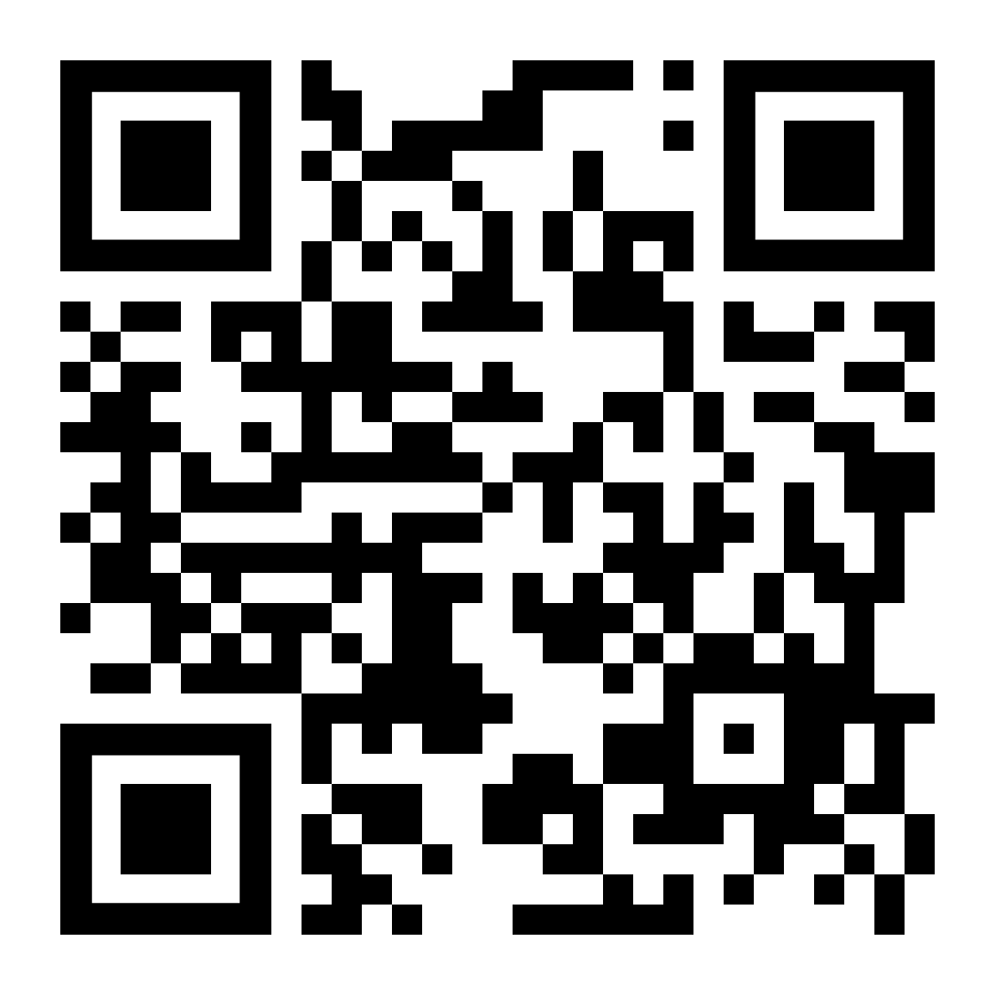
Orientation “Attendance” Confirmation Your Very First “100” in this course!
Please complete the below info link. It serves as:
Documentation of “attending” this presentation, and you will receive a 100 as your very first grade in this course!
Registration for meetings with Mrs. King.
https://forms.gle/JHWGJesejWbZ25fn8

